Slide 1
NYC Yellow Taxi Trip Analysis
A Hypothesis Testing Approach

Slide 2
Agenda
Problem Statement
Objective
Research Question
Data Overview
Methodology
Analysis and Findings
Hypothesis Testing
Recommendations

Slide 3

Problem Statement
In the fast-paced taxi booking sector, making the most of revenue is essential for long-term success and driver happiness.
Our goal is to use data-driven insights to maximize revenue streams for taxi drivers in order to meet this need.
Our research aims to determine whether payment methods have an impact on fare pricing by focusing on the relationship between payment type and fare amount.

Slide 4

Objective
To perform an A/B test on fare and payment method.
To analyze the relationship between total fare and payment type.
To use Python for hypothesis testing and data analysis.
To extract insights that help increase driver revenue.
To compare fares between card and cash payments.
To check if there is a significant difference in fares.

Slide 5

Research Question
Is there a relationship between total fare amount and payment type ?
can we nudge customers towards payment methods that generate higher revenue for drivers, without negatively impacting customer experience.

Slide 6
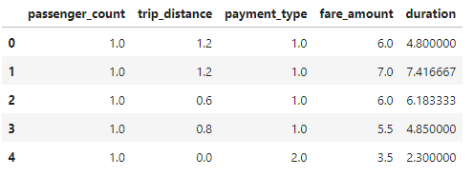
Data Overview
For this analysis, we utilized the comprehensive dataset of NYC Taxi Trip records, used data cleaning and feature engineering procedures to concentrate solely on the relevant columns essential for our investigation.
Relevant columns used for this research:
passenger_count (1 to 5)
payment_type (card or cash)
fare_amount
trip_distance (miles)
duration (minutes)

Slide 7
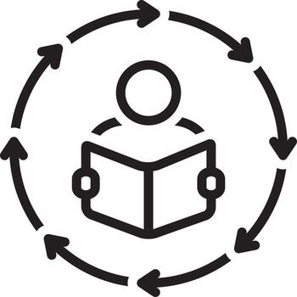
Methodology
Descriptive Analysis:
Performed statistical analysis to summarize key aspects of the data
focusing on fare amounts and payment types.
Hypothesis Testing:
Conducted a T-test to evaluate the relationship between payment type and fare amount.
testing the hypothesis that different payment methods influence fare amounts.
Regression Analysis:
Implemented linear regression to explore the relationship between trip duration (calculated from pickup and dropoff times) and fare amount.

Slide 8

Findings
Column1 | Payment Type | Mean | Standard Deviation
Fare Amount | Card | 13.7 | 6.5
 | Cash | 12.25 | 6.2
Trip Distance | Card | 3.23 | 2.32
 | Cash | 2.8 | 2.23
Average fare: Card (13.7) > Cash (12.25).
Average trip distance: Card (3.23) > Cash (2.8).
Variability in fares is slightly higher for card payments.
Customers prefer cards for high-value transactions.
Payment method has a measurable impact on revenue patterns.
Insights
Card payments show slightly higher average fare than cash.
Customers using cards tend to travel longer distances.
Higher fares are more commonly paid using cards.
Cash payments are more frequent for shorter trips and lower fares.
Fare and trip distance are positively related for both payment types.

Slide 9
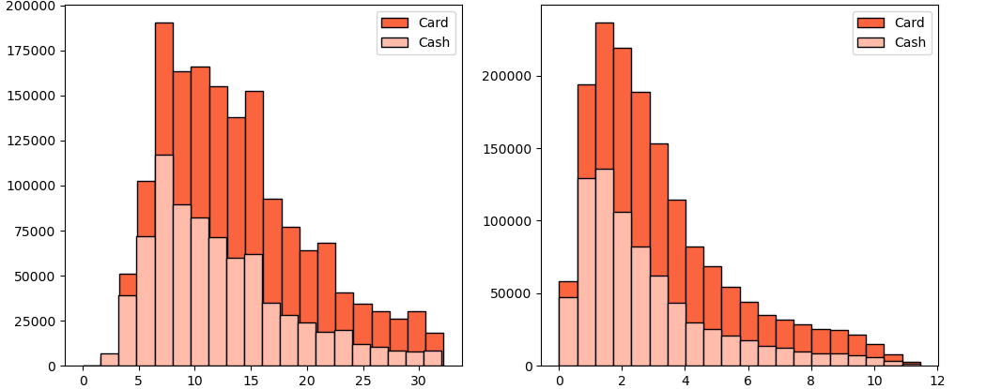
Fare Amount
Trip Distance

Slide 10

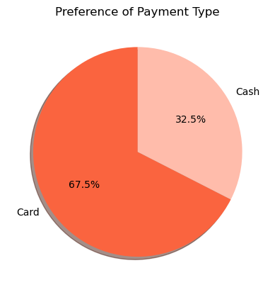
Preference of Payment Types
Card Payments are higher than Cash Payments.
Card Payments for 67.5% of transactions.
Cash Payments for 32.5% of transactions.
Customer is preferring card payment over cash.
Cards are chosen due to convenience and security.
Incentives may also influence card usage.

Slide 11
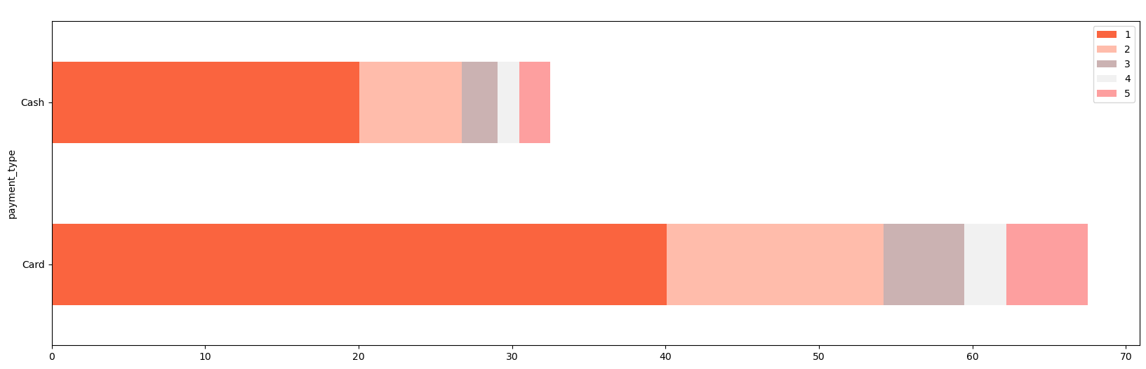
Passenger Count Analysis
Single passengers dominate: Rides with a single passenger comprise the largest proportion for both card (40.08%) and cash (20.04%) payments.
Larger groups less frequent: The percentage of transactions noticeably decreases as the passenger count increases.
Behavior insights: This trend suggests larger groups may opt for alternative transport or payment methods.
Key takeaway: Considering both payment method and passenger count offers valuable insights into customer behavior and preferences.

Slide 12
Hypothesis Testing
Null hypothesis: No difference in average fare between credit card and cash users.
Alternative hypothesis: There is a difference in average fare between the two groups.
Result: T-statistic = 165.5, P-value < 0.05.
Conclusion: Reject the null hypothesis.
Insight: Payment method significantly affects average fare.

Slide 13
Recommendations
Encourage customers to use credit cards.
Promote higher revenue through card payments.
Offer discounts or incentives for card usage.
Motivate customers to choose credit cards.
Provide secure and seamless payment options.
Improve convenience to increase adoption.

Slide 14
Thank You

